Slide 1

That’s Just Like, the Rules of Feminist Therapy
Elnora Heller
University of Virginia
February 23, 2019
Notes:
That’s just like the rules of feminist therapy

Slide 2
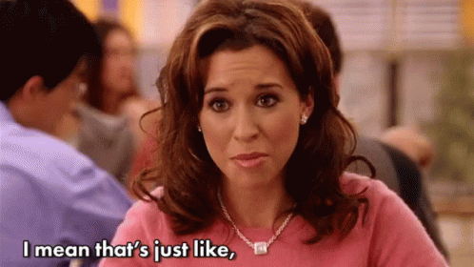
Notes:
Feminism is the belief that
human beings are of equal worth.
The patriarchal social structure currently in place maintains a hierarchy of dominance based on gender.
This must be resisted and transformed toward a more equitable system.
The goal is to bring inequities based on gender or sex into awareness and resolve them through egalitarian and nonpatriarchal solutions.
IT is based in intersectionality and is socially transformative

Slide 3
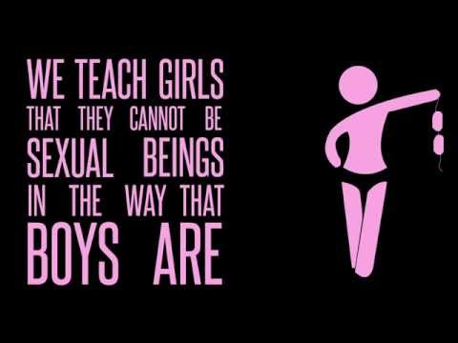
Notes:
CHIMAMANDA NGOZI ADICHIE FLAWLESS SPEECH

Slide 4
Major Theoretical Principles
Let’s get acquainted, shall we?
Notes:
Now we are going to delve into the major theoretical terms and principles of feminist therapy.

Slide 5
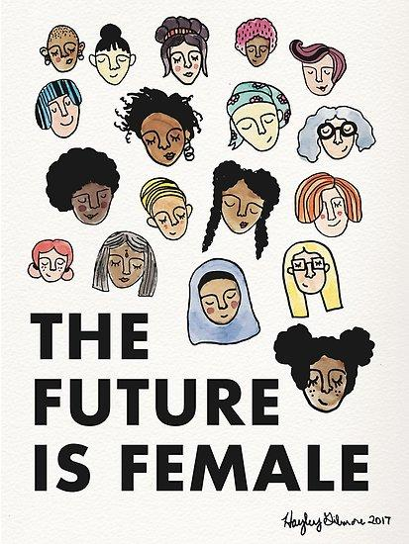
Major Theoretical Principles
Sex and gender powerfully affect identity
Pathology stems from an oppressive culture
Consciousness-raising is a part of healing and change
Body image
Notes:
sex and gender powerfully affect identity.
gender, and sexuality are extremely important.
Gender roles are rigid, culturally based behavioral expectations for males and females that they are expected to conform to based on their societally-defined gender. -------> distress and disempowerment,
does not conform to expectations and feels disappointment toward what is expected of them.
Sexuality may contribute to feelings of disempowerment and shame relating to gender roles, especially when males and females do not fit into cultural norms.
Therapists provide clients with an open and safe space where they can freely talk about their relationships, sexuality and intimacy.
They allow the client to determine their sexual identity, and do not promote and rigid ideas of normalcy.
Pathology or deviance is rooted in an oppressive, dysfunctional culture,
maleness is normative and preferred/normative definition of being human - this is the core tenet of feminist therapy.
When a culture marginalizes certain members and makes them feel inferior, it may cause psychological burdens.
It is important to remember that for feminist therapists, the problem does not reside in the individual - it is a burden forced upon them by an oppressive culture.
Consciousness-raising is a part of healing and change, including the important concept of the personal is political.
Consciousness-raising is increasing psychological awareness and development.
In order to grow, clients must recognize cultural oppression and stop blaming themselves for not fitting into certain constructs
free themselves from self-blame.
personal experiences are intertwined with, and cannot be separated from, the social-political cultural setting.
It is important to work with clients to increase their social interest and awareness.
Body image and ideals are also very prominent in society,
honoring the body is an important element of feminism and part of a core domain of power,
Many individuals suffer from negative self-image and body-related distresses
eating disorders, self-harm, psychosomatic disorders, and obesity, which occur in both males and females.
negative body image and ideals are more common in females, and traumas have the potential to affect the relationship with the body
It is important for feminist therapists to understand clients’ physical experiences and nonjudgmentally acknowledge the negative effects of trauma on the body, both emotionally and physically.

Slide 6

Power
Types of power:
Somatic power
Intrapersonal/intrapsychic power
Interpersonal/social-contextual power
Spiritual/existential power
Notes:
four types of client power that therapists analyze and work to strengthen, especially when a shortage in the domain leads to feelings of disempowerment.
somatic, which is related to body image and comfort.
It’s healthy for an individual to feel safe and secure, and be accepting of their body instead of having a preoccupation with socially-defined body ideals
If there is a shortage in this dimension, the client may have negative body image or physical dissociation.
intrapersonal/intrapsychic,
self-understanding, clarity of purpose, and emotional awareness.
Disempowerment in this domain may lead to focusing too much on other people’s thoughts and feelings, or past interactions that cannot be changed. There may be a preoccupation with taking care of others, and the individual may have difficulties being in tune with their feelings and wants.
interpersonal/social-contextual,
assertiveness, self-confidence and the ability to make a difference.
Lack of power in this domain is associated with feelings of helplessness, hopelessness, or isolation, and it is very common among oppressed people.
spiritual/existential
meaning in life and freedom to embrace preferred spiritual or religious practices.
If this dimension of power is lacking, clients may feel disconnected from the outside world and a sense of meaninglessness.

Slide 7
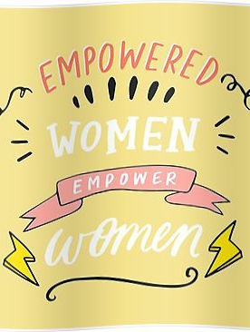
Why do we need feminism in schools?
Our culture is toxic to…
Girls
Boys
Those who challenge the gender binary
Notes:
Why we need feminism in schools
Culture is toxic to girls
In the last ten years, rates of depression among girls and women have increased twofold.
Suicide was the number one leading cause of death in teenage girls (ages 15-18) globally in 2014.
Among children as young as 6-8, half of girls feel they should be thinner.
billboards, grocery store shelves, and cell phone screens, sending sex-obsessed, slut-shaming, fat-shaming, whitewashed, youthwashed, heterosexist, cissexist, ableist messages, all with one take-away in common: you are not good enough.
2. Culture is toxic to boys Suicide is the third leading cause of death for boys.
Compared to girls, boys are two times more likely to flunk or drop out of school, two times more likely to receive special education services, and four times more likely to be expelled.
Boys too benefit from deconstructing these systems. Without deconstructing them, you can’t reconstruct a culture that allows boys to show emotions without social repercussions. Or a world that allows boys to solve a problem without violence.
3. Our culture is toxic to those who challenge the gender binary
The reality is that trans youth and queer youth of color are among our most vulnerable school populations. Gender Studies courses not only increase their positive representation in the curriculum but they also educate the masses who have the privilege to be unaware of LGBTQIA+ issues and are the ones most likely to create a hostile educational environment.

Slide 8

Notes:
Culture is toxic to boys
Suicide is the third leading cause of death for boys.
Compared to girls, boys are two times more likely to flunk or drop out of school, two times more likely to receive special education services, and four times more likely to be expelled.
Boys too benefit from deconstructing these systems. Without deconstructing them, you can’t reconstruct a culture that allows boys to show emotions without social repercussions. Or a world that allows boys to solve a problem without violence.

Slide 9
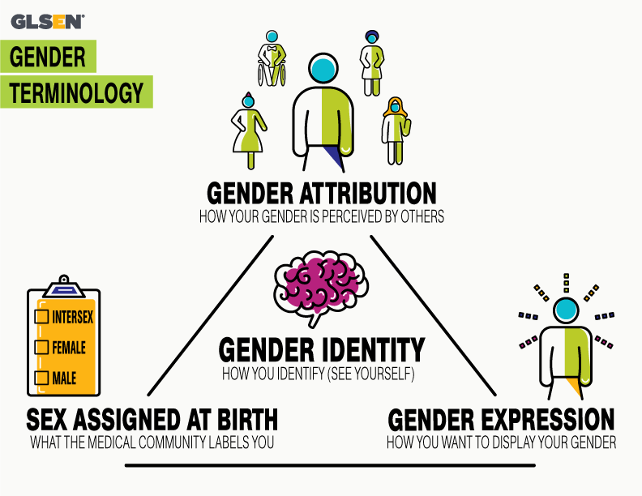
Notes:
I dont know if i want to use this picture somewhere, TBD
3. Our culture is toxic to those who challenge the gender binary
The reality is that trans youth and queer youth of color are among our most vulnerable school populations. Gender Studies courses not only increase their positive representation in the curriculum but they also educate the masses who have the privilege to be unaware of LGBTQIA+ issues and are the ones most likely to create a hostile educational environment.

Slide 10
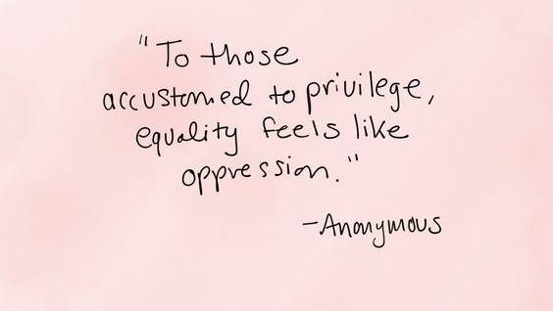
Notes:
SYSTEMS OF PRIVILEGE NEED CONFRONTING
Perhaps the number one rule of privilege is that if you have it, you are far less likely to notice it. Thus, men move about oblivious to their male privilege, straight people oblivious to their straight privilege, and cisgender people oblivious to their cis privilege. (white)
You can’t dismantle systems of which you are unaware. Gender Studies courses make moving about obliviously impossible. And with organizations like Everyday Feminism and Rethinking Schools, there is now no shortage of curricular resources available

Slide 11
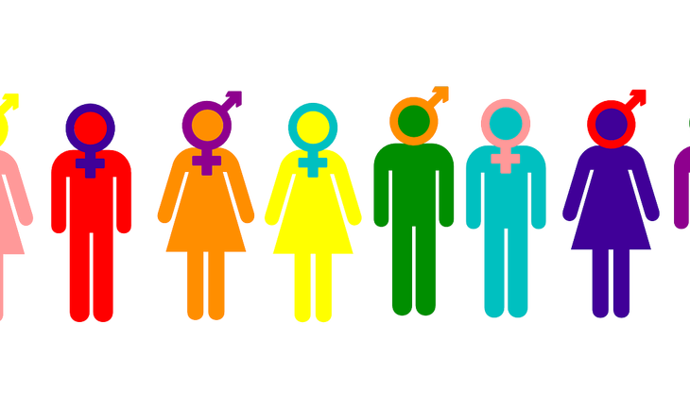
Notes:
Our movement becomes less powerful if we are leaving people behind!!!!!!!!!!!!!!!!
At its core, multicultural teaching is an ethical, even political, enterprise. Its aim is not just to impart lots of interesting facts,
equip students to help make the world a better place.
highlights injustice of all kinds – racial, gender, class, linguistic, ethnic national, environmental – in order to make explanations and propose solutions.
It recognizes our responsibility to fellow human beings and the earth. It has heart and soul (Bigelow, 1999, p. 5).
Feminist therapy has the same core. “Feminist consciousness also includes a commitment to ending all forms of domination, oppression, and privilege that intersect with sexism and gender bias, including (but not limited to) racism, classism, colonialism, heterosexism, ethnocentrism, white supremacy, ageism, and ableism” (Enns, 2004, p. 8).

Slide 12
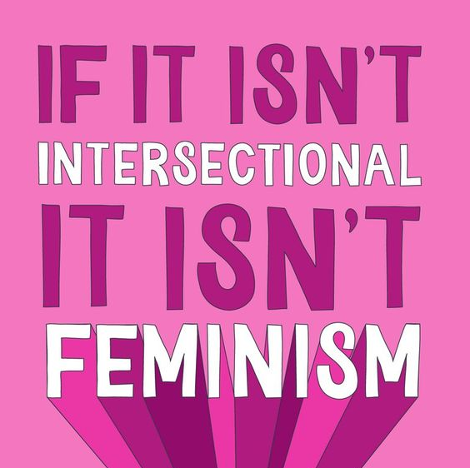

Slide 13
Feminism and Norms
Societal norms
Community norms
Family norms
School norms
Group norms
Peer norms
Notes:
Each one bleeds into the next
What society dictates, the political climate changes those. What is happening rn
Community - how they feel about the issue, pipeline, water (flint)
Family- do you agree with them, is gay wrong? Divorce? All people treated equally and with respect? How do they dictate what you believe. Why teenagers struggle with identity. Challenge fanily norms
Believe what family believes or transform into what their peers agree
Group norms - what are the norms of a small group of people where do you fall into. Church groups, mom groups, wine club, book club. We try to adhere closely to norms. Social contructions how does that feed into toxic masculinity, female pressure to be perfect
Peer -

Slide 14
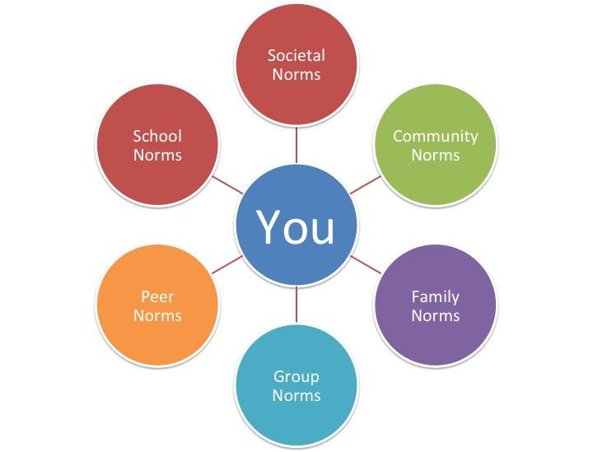
Notes:
List three norms you feel for each category - how do these norms align with your beliefs? Do you follow them?
What does it look like for adults
Focus on school peer group what do they look like?

Slide 15
Boy World
Girl World
Notes:
What is on your list? Are there any that you agree with? Disagree with? Why?
W
What does it look like for students
Strong personal identity - personal norms
What does boy world look like in schools? Suburban neighorbood, urban school? Middle school? High school? Religious? Private school?
Kids act differently in different arenas
-church
Dinner
-friends

Slide 16
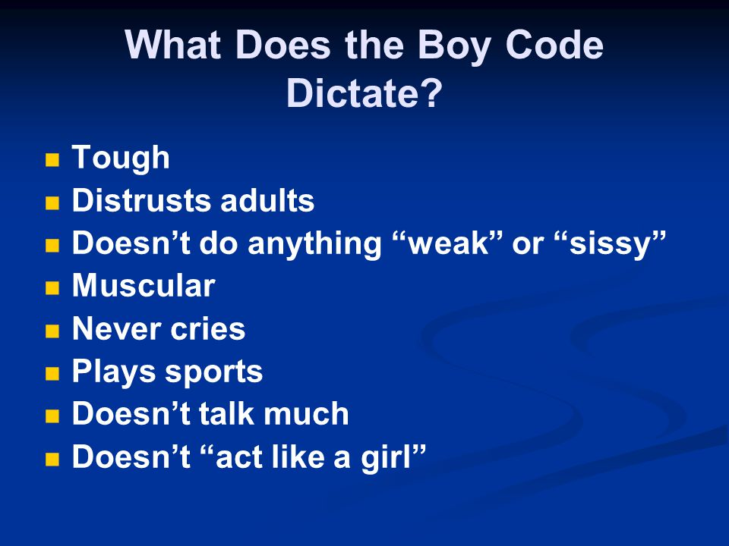


Slide 17
In Schools...
Help students see the patterns and social forces that have diminished their sense of power and control
Encouraging students to reclaim power, authority, and direction in their lives
Allowing students to experience this shared power in the counseling relationship
Honoring and facilitating female ways of being or feminist consciousness
Notes:
In feminist therapy, the process is primarily focused on consciousness-raising and awareness. There are four prominent therapy goals, and they are not eclectic.
The first goal of therapy is helping clients see the patterns and social forces that have diminished their sense of power and control.
Teacher has power. Student has control. Help the student to recognize the control that they have in the classroom
The second goal is encouraging clients to reclaim power, authority, and direction in their lives.
Student has control over how much they will learn/participate/grow
The third goal is allowing clients to experience this shared power in the therapy relationship
collaborate in power, decision-making, goal selection, and learning.
The fourth goal is honoring and facilitating female ways of being or feminist consciousness
including growth stemming from deep, connected, intimate relationships.

Slide 18
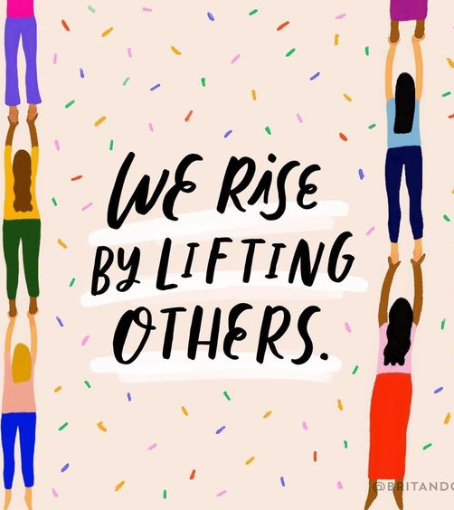
Counseling Relationship
Egalitarian Relationship
Student is understood in the context of his/her culture
Empower student
Notes:
Multicultural counseling promotes an egalitarian relationship between counselor and client;
such is also a basic principle of Feminist Counseling.
goal of the competent multicultural counselor is to create a space in which a client can be understood in the context of his/ her culture, gender, sexuality, etc., and free from judgment in order to facilitate healing.
the goal of feminist therapists is to empower a client to break from patterns of societal oppression and heal.

Slide 19
School Counselor Interventions
Consciousness raising paired with body based awareness techniques
Media literacy to combat self-objectification
  Involve parents and school staff
Challenge gendered career stereotypes
  Career role models in nontraditional fields

Slide 20
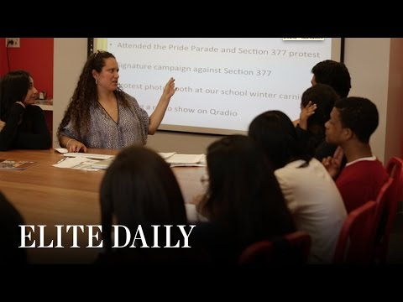
School Counselor Interventions
Notes:
This is a good example of a teacher who uses feminist curriculum to empower her students. As school counselors we might not be able to lead an entire feminism class, but we could do something similar through group counseling or an after-school club.
Start at 1:17

Slide 21
Takeaways for School Counselors
Can be used with any student
Empowering identities
Promoting healthy body image and self-esteem
Gaining independence, personal growth and power
Allows marginalized voices to be heard
Increasing hope and confidence
Notes:
There are a lot of takeaways of the feminist approach for school counselors. Importantly, it can be used with any of your students, because it is inclusive of all cultures, sexualities, and genders.
Empowerment of children and adolescents is important, especially in identity formation and the promotion of healthy body image and improving self-esteem.
It is also important to help your students explore healthy, beneficial ways of personal growth and gaining autonomy and power in their lives. However, some clients may be afraid or uninterested in working with you due to your feminist ideals, so it is important to inform to your clients that the sessions are about them and will allow them to feel empowered and respected, and you will never force your values onto them.
This approach is also an excellent way for marginalized voices to be heard, honored, and supported. The goal here is to mutually embrace your students’ personal power and growth, along with increasing their hope and confidence about themselves and the world.

Slide 22
Resources
Empowering students - https://www.mindmatters.edu.au/docs/default-source/learning-module-documents/module_2-4-moduleoverview.pdf
Meaningful student involvement - https://soundout.org/student-empowerment/
Teaching Tolerance - https://www.tolerance.org/
Creating Safe and Welcoming Schools - http://www.welcomingschools.org/
Human Rights Campaign - https://www.hrc.org/
Gay Straight Alliance - https://gsanetwork.org/
Million Women Mentors - https://www.millionwomenmentors.com
A Mighty Girl - https://www.amightygirl.com
Notes:
Here are some resources that we found that could be used by school counselors for situations like Natasha’s, along with other students. The first resource is a link to an educator toolkit by the National Eating Disorders Association, which provides resources for school faculty to work with and support students with eating disorders. It includes prevention, evaluation, and intervention tools.
The second resource is a module on empowering students from an Australian mental health initiative group. It provides information on how to empower students in various domains in a school setting.
The third resource provides information on how to get students meaningfully involved in school, giving toolkits for both educators and students.
Finally, if you want to get involved in the fourth wave of feminism, the annual Women’s March on Washington will be held on Saturday, January 19th. It is free to attend, and is a great way to get involved and show your support for the movement. I will be going!

Slide 23
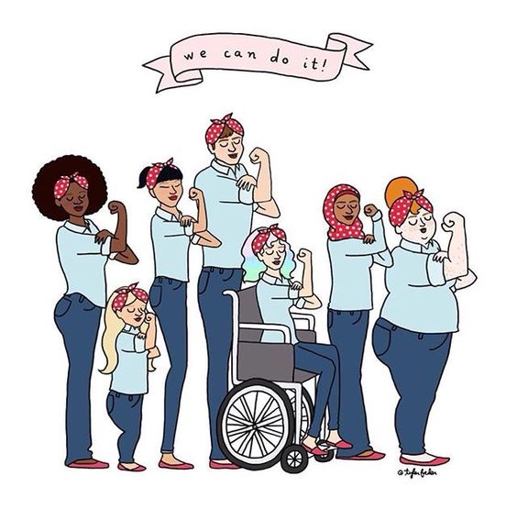

Slide 24
A woman without a man is like a fish without a bicycle.
-Gloria Steinem
Notes:
Here is a powerful quote from Gloria Steinem, an American feminist, who was a leader of the feminist movements in the 1960s and 1970s. A woman without a man is like a fish without a bicycle. This is a pretty powerful analogy, because it reiterates the idea that a woman does not need a man to succeed or achieve happiness in any aspect of her life.

Slide 25
Thank You!
Any questions?
You can find me at
https://elnoraheller.wixsite.com/elnoraheller
emh3gn@virginia.edu

Slide 26
References
Beck, D.B. (1998). The “F” word: How the media frame feminism. NWSA Journal 10 (1) 139-153. Johns Hopkins University Press. Retrieved from http://www.jstor.org/stable/4316558
Choate, L., & Curry, J.R. (2009). Addressing the sexualization of girls through comprehensive programs, advocacy, and systemic change: Implications for professional school counselors. Professional School Counseling, 12(3), 213-222.
Enns, C. Z. (1993). Twenty Years of Feminist Counseling and Therapy. The Counseling Psychologist,21(1), 3-87. doi:10.1177/0011000093211001
Hinkelman, Lisa M. (2013). Girls without limits: Helping girls achieve healthy relationships, academic success, and interpersonal strength. SAGE Publications.
Sommers-Flanagan, J., & Sommers-Flanagan, R. (2018). Counseling and psychotherapy theories in context and practice: Skills, strategies, and techniques. John Wiley & Sons.
Stromback, M., Malmgren-Olsson, E., & Wiklund, M. (2013). ‘Girls need to strengthen each other as a group’: experiences from a gender-sensitive stress management intervention by youth friendly Swedish health services—a qualitative study. BMC Public Health. Retrieved from http://www.biomedcentral.com/1471-2458/13/907

